Slide 1
Halftone patterns and dithering techniques
Chapter 10

Slide 2
DISPLAYING LIGHT INTENSITIES
Values of intensities calculated by illumination model must be converted to one of the allowable intensity levels for the particular graphics system in use.
Systems can display several intensity levels or just two.
We convert intensities from lighting model into one of the available levels for storage in the frame buffer.
For bilevel we can convert intensities into halftone patterns

Slide 3
Assigning Intensity levels
We perceive light intensities the same way that we perceive relative sound intensities : on a logarithmic scale.
If the ratio of two intensities is the same as the ratio of two other intensities , we perceive the difference between the each pair of intensities to be the same.
We perceive the difference between the intensities 0.20 and 0.22 to be the same as the difference between 0.80 and 0.88
To display n+1 successive intensity levels with equal perceived brightness , the intensity levels on the monitor should be spaced so that the ratio of successive intensities is constant.
I₁ /I₀ = I₂ /I₁ = ----------- = I_{n} /I_{n-1} = r-----------A

Slide 4
DISPLAYING LIGHT INTENSITIES
I0 is the lowest level and In is the highest intensity level that can be displayed on the monitor. Any intermediate intensity can then be expressed in terms of Io as
I_{k} = r^{k} I₀
The value of r can be calculated (for given values of I₀ and n) for particular system by substituting k = n in the above expression. since I_{n} = 1, r = (1/ I₀ ) 1/n
Thus the calculations for Ik can be written as
I_{k} = I₀ ^{(n-k)/n} if I₀ = 1/8 for a system with n =3 we have r=2 and four intensity levels as 1/8 , ¼ , ½ and 1.
The lowest intensity value I₀ depends on the characteristic of the moitor and is typically in the range from 0.005 to 0.025

Slide 5
Gamma correction and Video lookup Table
Non linearity of display devices is another problem associated with the display of intensities.
The calculated intensities are stored in a file as integer values with one byte assigned to each RGB component.
The intensity file is also linear (pixel with value 64,64,64 has ½ intensity as compared with pixel having values 128,128,128.
Video montor is a non linear device , If we set the voltage for the electron gun proportional to the linear pixel values , the displayed intensities will be shifted according to the monitor response curve.
To correct for monitor non linearities graphics systems use a video lookup table that adjust the linear pixel values

Slide 6
Gamma correction and Video lookup Table
The monitor response curve is described by the exponential function I = aV^{Ƴ} , where I is the displayed intensity and V is the input voltage.
values for parameters a and Ƴdepend on the characteristics of the graphics system.
In order to display I intensity the value of voltage required will be
V =( I ^{1/Ƴ} / a)
This calculation is referred as gamma correction of intensity which is used to set up video lookup table that converts integer pixel values in the image file to values that control the electrone gun voltage.
If I is the input intensity value from an illumination model we can determine the level number of the intensity value I_{k} corresponding to this intensity from table of values.
K = round(log _{r} I/I₀)
Then we compute the intensity value at this level Ik , once we have Ik we can calculate electron gun
Vk = (I_{k}/a)^{1/Ƴ}

Slide 7
Halftoning
Continuous tone photographs are reproduced for publication in newspapers , magazines and books with printing process called halftoning and the reproduced pictures are called halftones .
B/W photograph each constant intensity area is reproduced as a set of small black circles on a white background.
The D_circle is proportional darkness required

Slide 8
Halftone approximation
In computer graphics halftone reproduction is simulated using rectangular pixel regions called halftone approximation patterns or just pixel patterns.
Intensity level depends upon the no. of pixels in the grid.
nXn pixel on bilevel system represents n2+1 intensity levels

Slide 9
Halftone approximation cont..
the following patterns are used for each pixel of 5 intensity levels.
0 1 2 3 4
0.0<=I<=0.2 0.2<=I<=0.4 0.4<=I<=0.6 0.6<=I<=0.8 0.8<=I< 1.0
What if we have to display ten intensity levels.
Use 3X3 pixel grid..one way to set up the grid is shown in next slide.

Slide 10
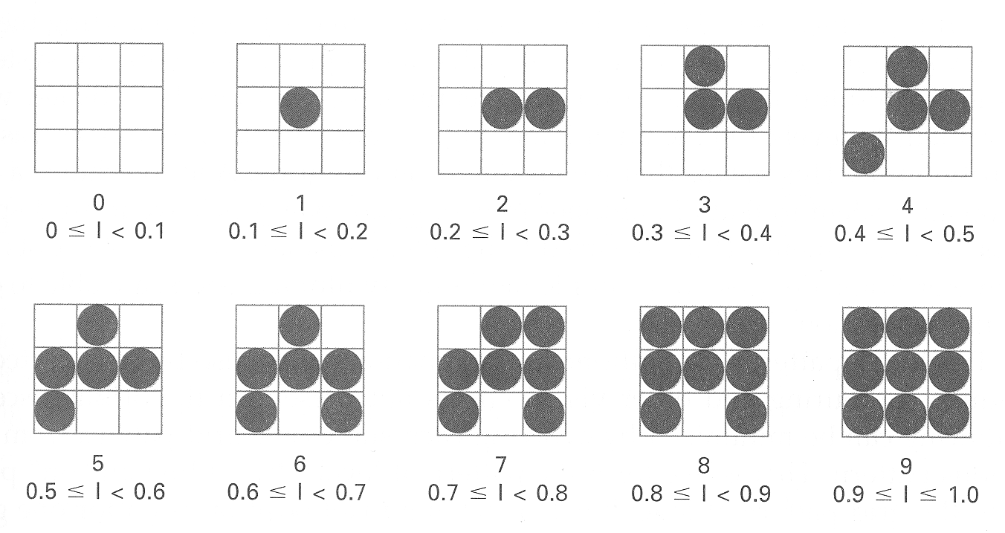
Ten intensity level grid

Slide 11
Pixel mask
For any pixel grid size we can represent the pixel patterns for the various possible intensities with a mask of pixel position numbers.
Mask for 3X3 grid pattern
To display a particular intensity with level number k , we turn on each pixel whose position number is less than or equal to k
8 | 3 | 7
5 | 1 | 2
4 | 9 | 6

Slide 12
Problems with grid pattern
Decrease the resolution by a factor of 1/n in the x and y direction for nXn grid.
Subgrid patterns became apparent as the grid size increases.
Thus for lower resolution we must use fewer intensity levels.
High quality display require at least 64 intensity levels.. Means 8X8 grid…and to achieve resolution equal to halftones in books and magzines we must display 60 dots per cm
We need to be able to display 60X8=480 dots per cm for required affect

Slide 13
Minimising contoring and visual effects
Contoring can be minimised if we derive the next grid pattern from the previous one.
We form pattern at level k by adding an on

Slide 14
Dithering
Distribute errors among pixels
Exploit spatial integration in our eye
Display greater range of perceptible intensities

Slide 15
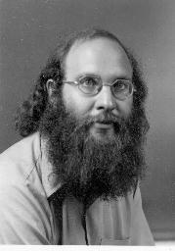
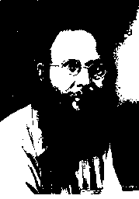
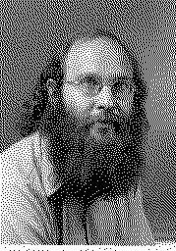
Example
Original (8 bits) Uniform Quantization (1bit) Floyd –Steinberg Dither 1bit

Slide 16
Bayer’s ordered dither matrices

Slide 17
Illumination Models and Surface-Rendering Methods
Realistic displays are obtained by generating perspective projections of objects and applying natural lighting effects to the visible surfaces
Illumination model and a lighting model is used to calculate the color of an illuminated position on the surface of an object
Surface rendering method uses the color calculations from an illumination model to determine the pixel colors for all projected positions in a scene

Slide 18
What is Surface Rendering?
Apply illumination model first
Use color calculations from illumination model to determine pixel color

Slide 19
Constant-Intensity Surface Rendering
The simplest method for rendering a polygon surface
The same colour is assigned to all surface positions
The illumination at a single point on the surface is calculated and used for the entire surface
Flat surface rendering is extremely fast, but can be unrealistic

Slide 20
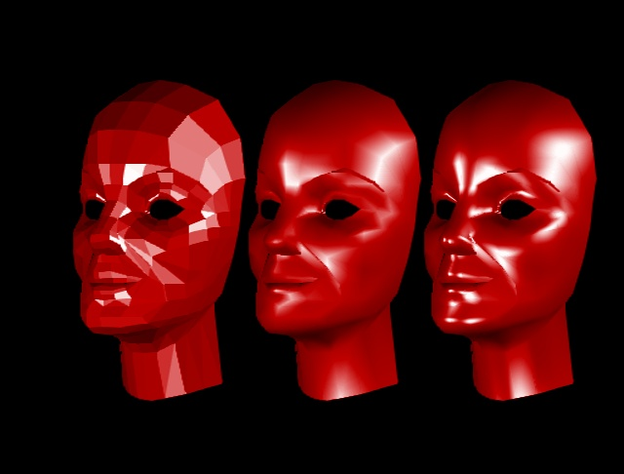
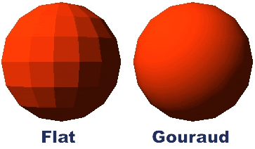
Constant-Intensity Surface Rendering
Problem: the polygon surfaces show up very clearly (facetted appearance)

Slide 21
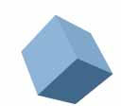
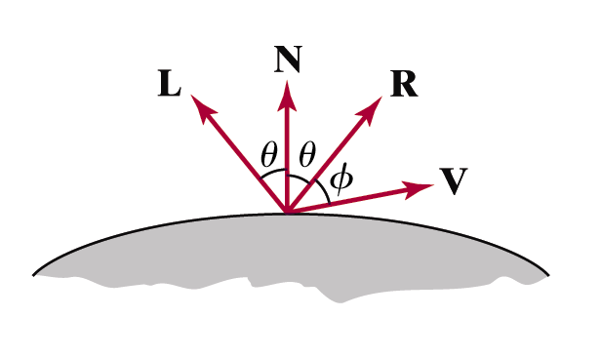
Constant-Intensity Surface Rendering
So when does it work?
The polygon is one face of a polyhedron, not a section of a curved-surface approximation mesh
All light sources sufficiently far:
N•L is constant
Attenuation function is constant
Viewing position sufficiently far:
V•R is constant

Slide 22
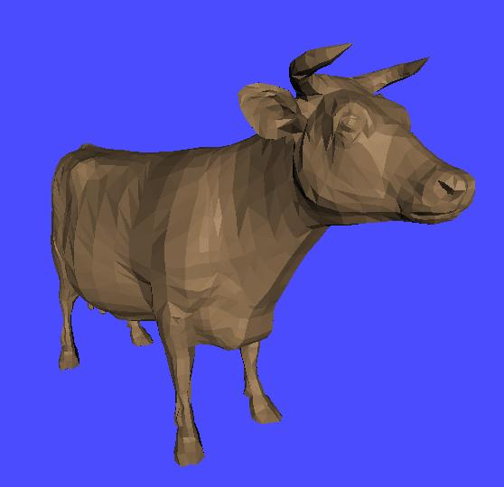
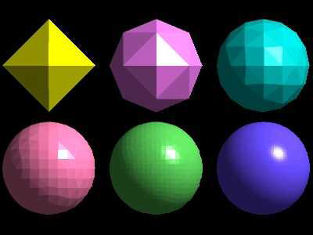
Flat shading example

Slide 23
Gouraud Surface Rendering
Examples
Flat
Gouraud
Flat
Gouraud

Slide 24
Gouraud Surface Rendering
To render a polygon, Gouraud surface rendering proceeds as follows:
Determine the average unit normal vector at each vertex of the polygon
Apply an illumination model at each polygon vertex to obtain the light intensity at that position
Linearly interpolate the vertex intensities over the projected area of the polygon

Slide 25
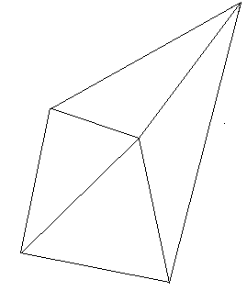
Gouraud Surface Rendering (cont…)
The average unit normal vector at v is given as:
or more generally:
N₁
N_{v}
v
N₄
N₂
N₃

Slide 26
Gouraud Surface Rendering (cont…)
Illumination values are linearly interpolated across each scan-line
y
3
1
Scan-line
4
p
5
2
x

Slide 27
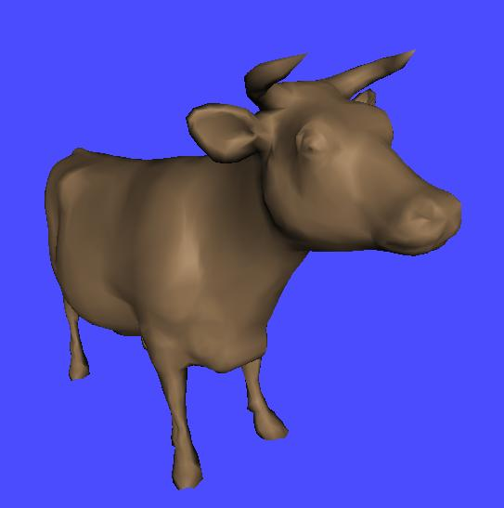
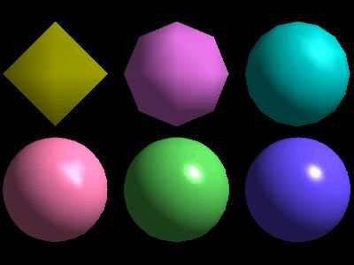
Gouraud Surface Rendering Example
Images come from: http://www-static.cc.gatech.edu/classes/AY2004/cs4451a_spring/ shading_models/linint.html

Slide 28
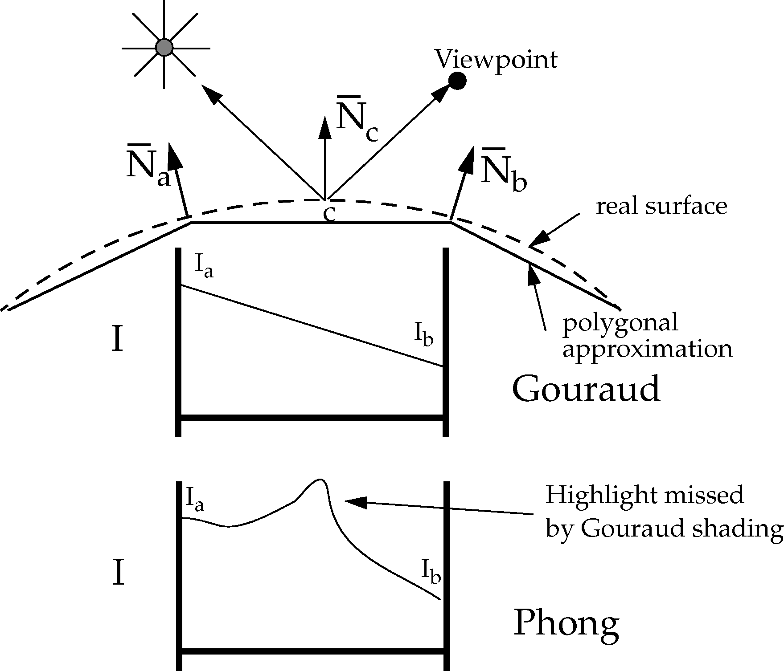
Problems With Gouraud Shading
Gouraud shading tends to miss certain highlighting In particular Gouraud shading has a problem with specular reflections
Also, Gouraud shading can introduce bright or dark
streaks known as Mach bands

Slide 29
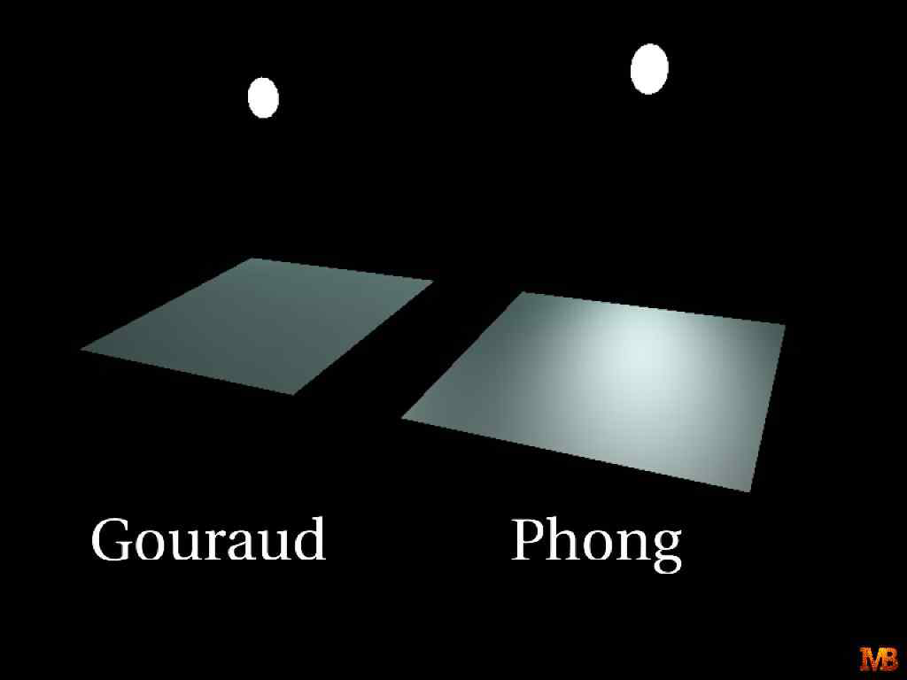
Highlights on the surface are displayed with anomalous shapes

Slide 30
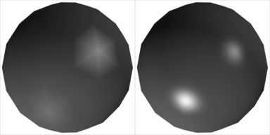
Problems With Gouraud Shading (cont…)
Gouraud shading
Phong shading
The major problem with Gouraud shading is in handling specular reflections

Slide 31
Sol. Of Gouraud Shading Problem
To reduce the anomalous effects,
Divide the surface into a greater number of poly gonfaces
Use more precise intensity calculations

Slide 32
Phong Surface Rendering
A more accurate interpolation based approach for rendering a polygon was developed by Phong Bui Tuong
Basically the Phong surface rendering model (or normal-vector interpolation rendering) interpolates normal vectors instead of intensity values

Slide 33
Phong Surface Rendering (cont…)
To render a polygon, Phong surface rendering proceeds as follows:
Determine the average unit normal vector at each vertex of the polygon
Linearly interpolate the vertex normals over the projected area of the polygon
Apply an illumination model at positions along scan lines to calculate pixel intensities using the interpolated normal vectors

Slide 34
Phong Surface Rendering (cont…)
N₃
N₁
N₄
N_{p}
Scan line
p
N₅
N₂

Slide 35
Phong Surface Rendering Implementation
Phong shading is much slower than Gouraud shading as the lighting model is revaluated so many times
However, there are fast Phong surface rendering approaches that can be implemented iteratively
Typically Phong shading is implemented as part of a visible surface detection technique

Slide 36
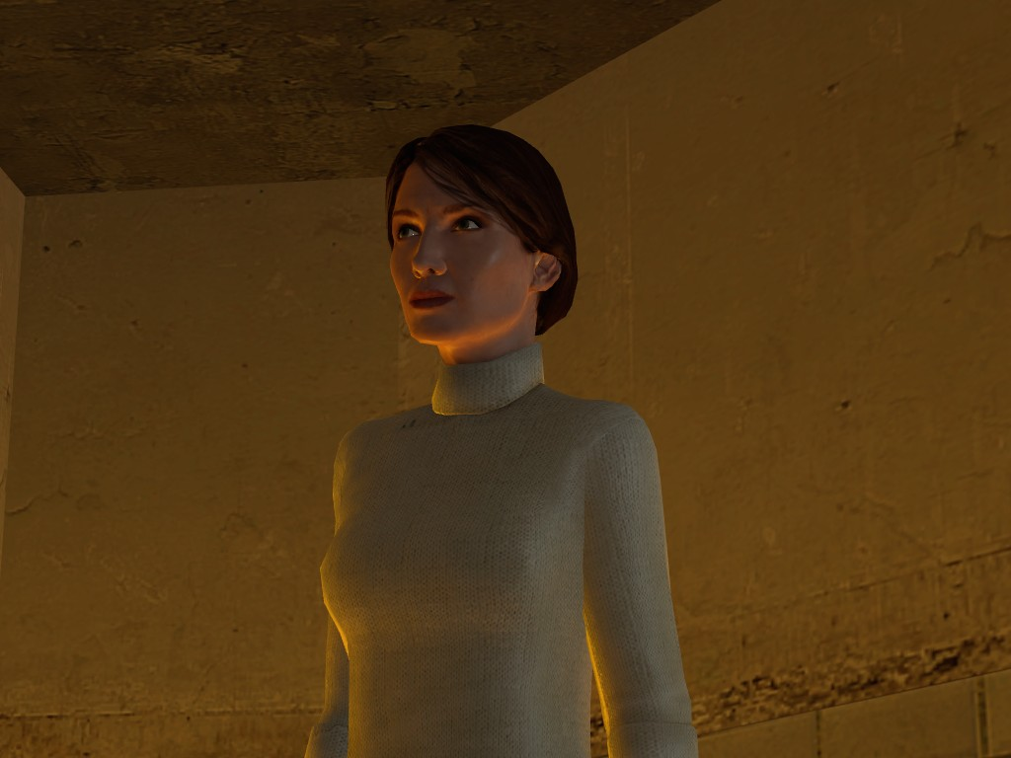
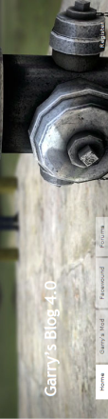
Phong Shading Examples
Images come from Garry’s Mod: http://www.garry.tv/

Slide 37
Phong Surface Rendering
Flat
Gouraud
Phong

Slide 38
Summary
For realistic rendering of polygons we need interpolation methods to determine lighting positions
Flat shading is fast, but unrealistic
Gouraud shading is better, but does not handle specular reflections very well
Phong shading is better still, but can be slow

